Slide 1

Case Study Of
Prathamesh Ram Gosavi

Slide 2
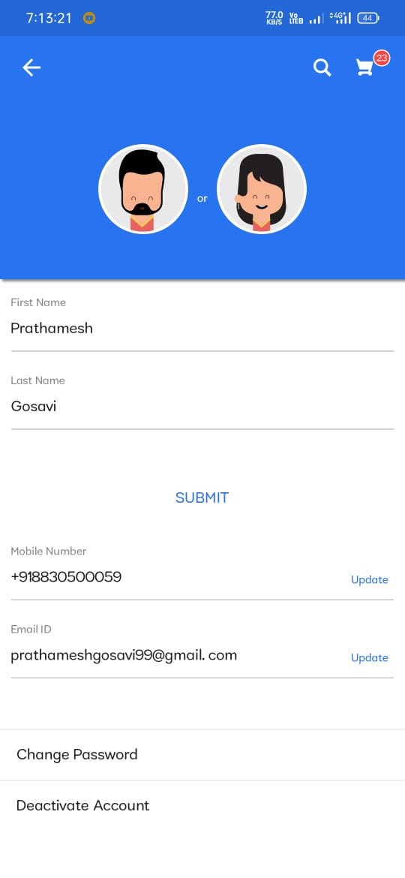
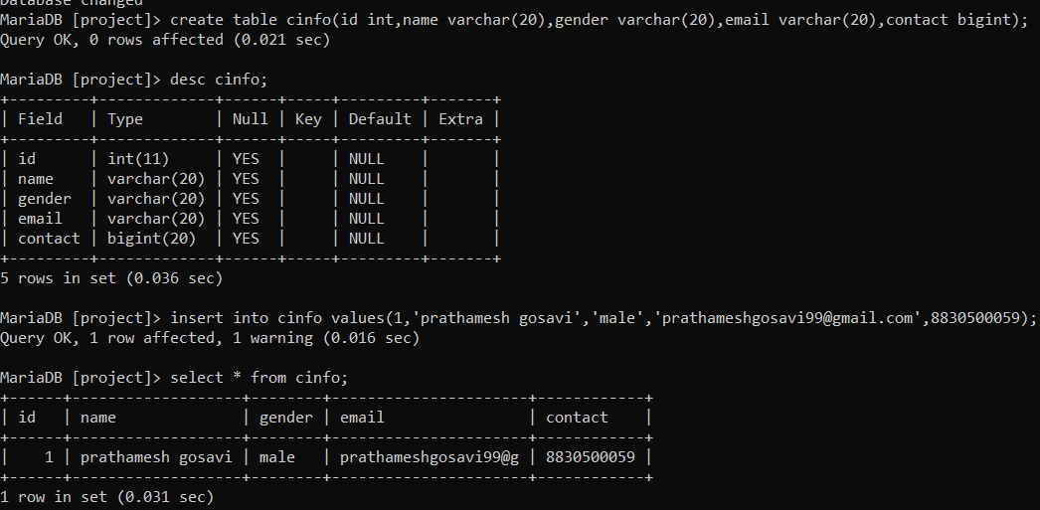
To create table and insert values
TO CREATE TABLE:- create table cust(id int,name varchar(20),gender varchar(20),email varchar(20),contact bigint);
T0 INSERT VALUES:-insert into cinfo values(1,’prathamesh gosavi','female','shreya@gmail.com’,8830500059);
TO SEE DATA IN TABLE:-select *from cinfo;

Slide 3
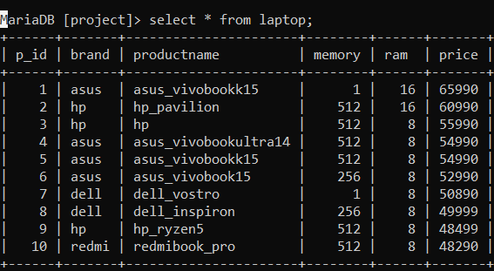
Product Table
Create table laptop(p_id int,brand varchar(20),product name varchar(20),memory int,ram int,price int);
Insert into laptop values(1,’asus’,’asus_vivobook’,1,16,65990),
(2,’hp’,’hp_pavillion’,512,16,60990),
(3,’hp’,’hp’,512,8,55990),
(4,’asus’,’asus_vivobookultra14’,512,8,54990),
(5,’asus’,’asus_vivobook15’,512,8,54990),
(6,’asus’,’asus_vivobook15’,256,8,52990),
(7,’dell’,’dell_vostro’,1,8,50890),
(8,’dell’,’dell_inspiron’,256,8,49999),
(9,’hp’,’hp_ryzen5’,512,8,48499),
(10,’redmi’,’rdmibook_pro’,512,8,48290);
SHOW TABLE
select * from laptop;

Slide 4
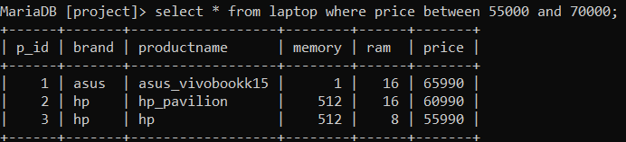
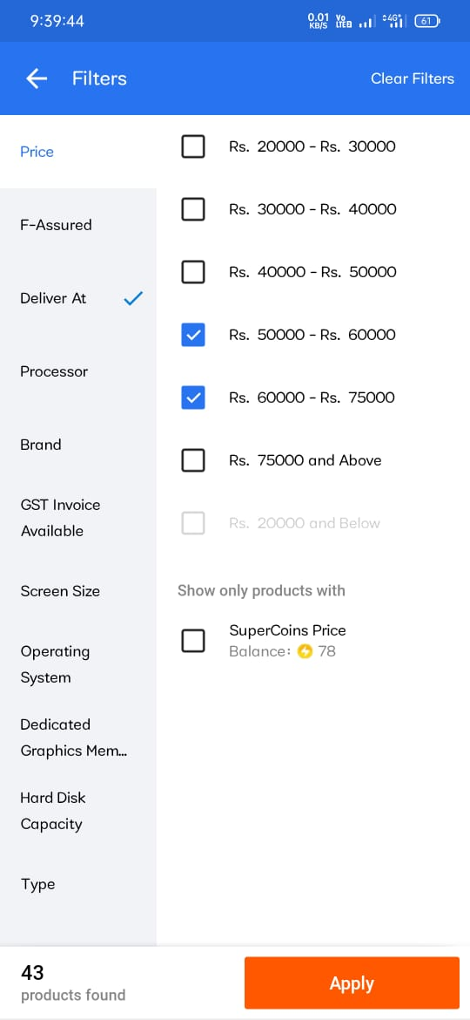
Applying Filter
Query For Applying Filter-
select * from laptop where price between 55000 and 70000;

Slide 5
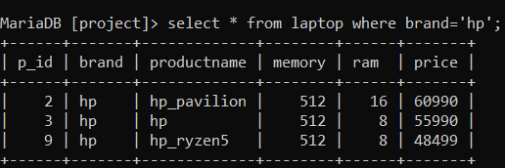
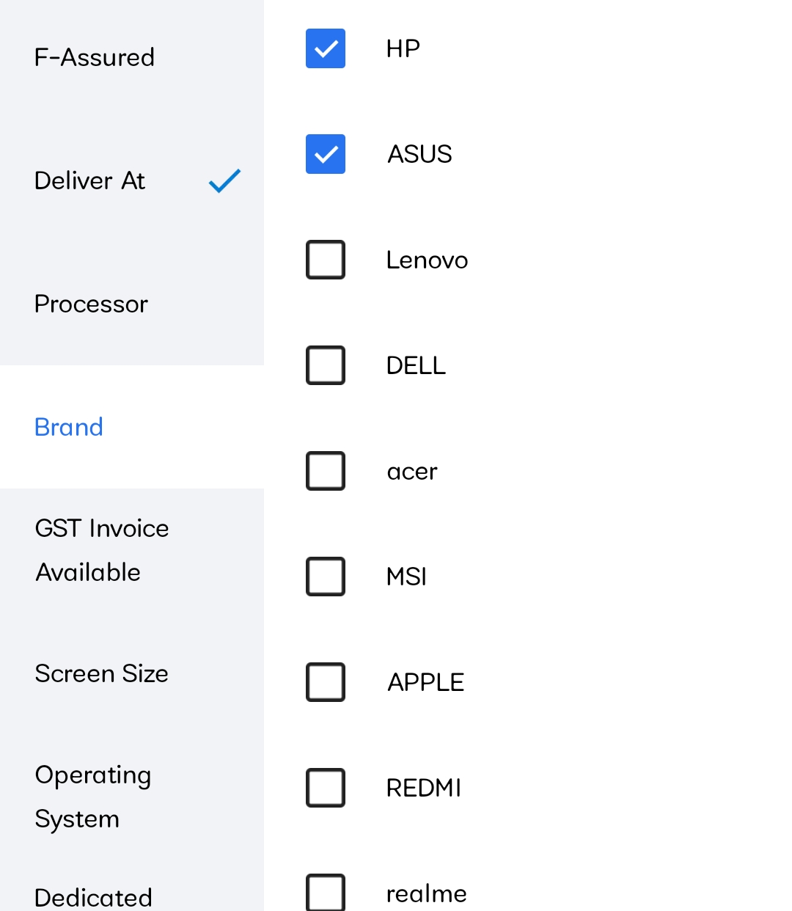
Choosing Brand
Query For choosing Brand-
select * from laptop where brand=‘hp’;

Slide 6
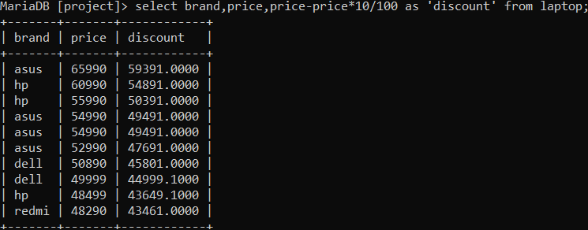

Applying Discount
Query For Applying Discount-
select brand,price,price-price*10/100 as ‘discount’ from laptop;

Slide 7
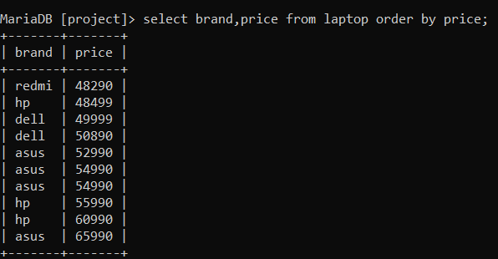
Ordering Price From Lowest To Highest
Query for Ordering Price From Lowest To Highest-
Select brand,price from laptop order by price;

Slide 8
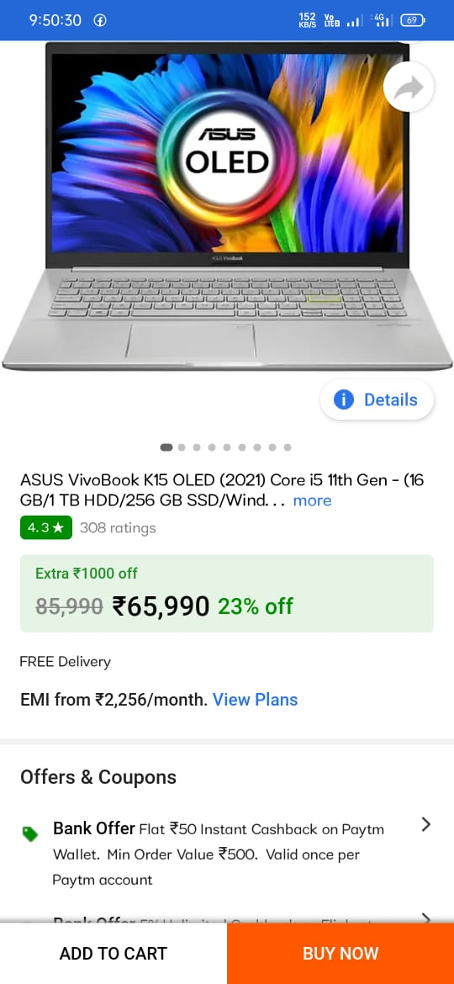
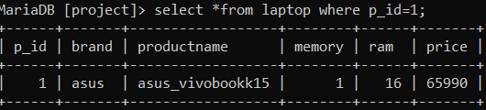
Selecting Product
Querry for selection Of Product-
select * from laptop where p_id=3;

Slide 9
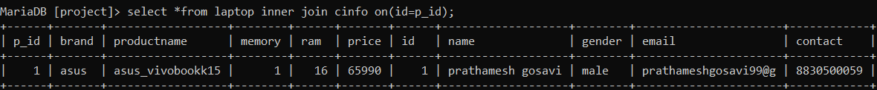
Place Order
Querry for Place Order-
select * from laptop inner join cinfo on(id=p_id);

Slide 10
Thank You

